Slide 1


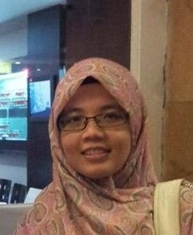
Open CV and Python 101
Siti Sofiah Binti Mohd Radzi
Ph.D (Electronics Engineering UMP)
M.Eng (Electronics and Communication, University of Sheffiled, UK
28th April 2018, MAGIC, Cyberjaya

Slide 2
ModuLE OVERVIEW
Slot 1(10-10.30): Introduction to Computer Vision
Slot 2(10.30-11.00): Installation of Anaconda and OpenCV configuration (Windows)
Slot3(11.00pm-12.30): Basic Image Operations and Examples
Slot 4(2-2.30):Overview of Object Detection methods(Haar, HOG)
Slot 5(2.30-4.00): Examples
Slot 6(4-6) : Exercises

Slide 3
InTRODUCTIOn TO COMPUTER VISION
1

Slide 4
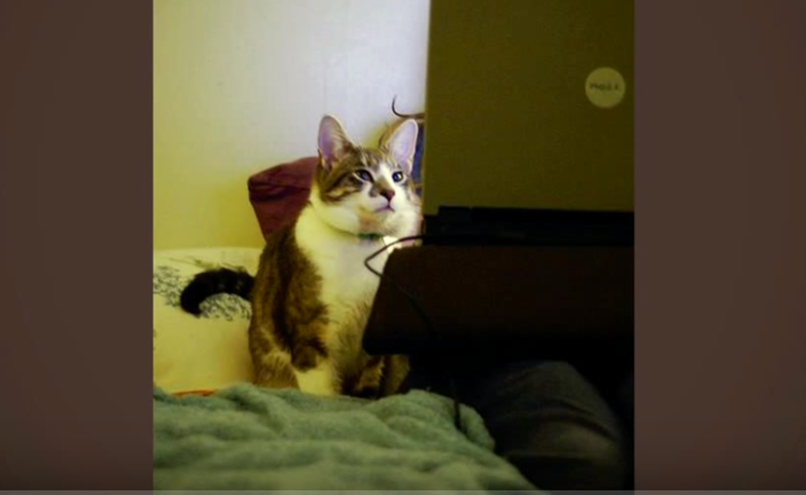

Slide 5
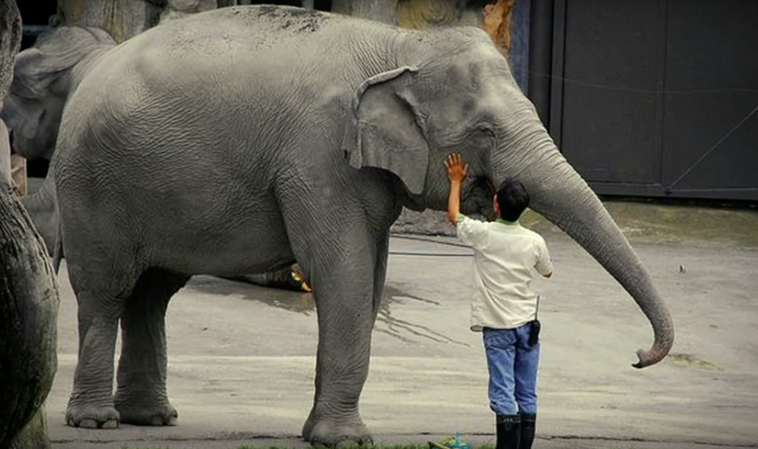

Slide 6
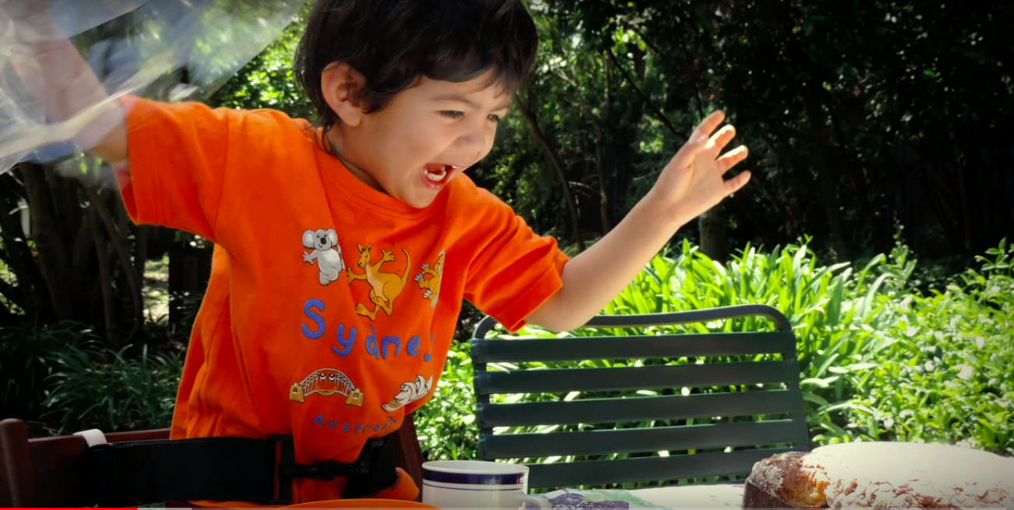

Slide 7
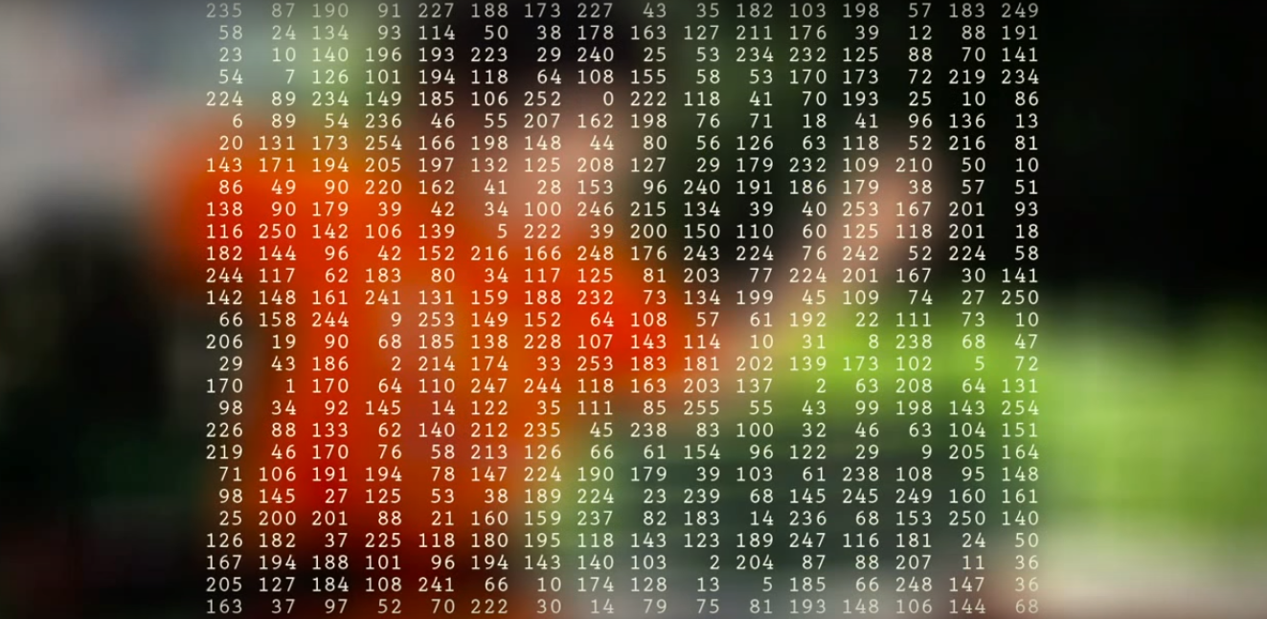

Slide 8
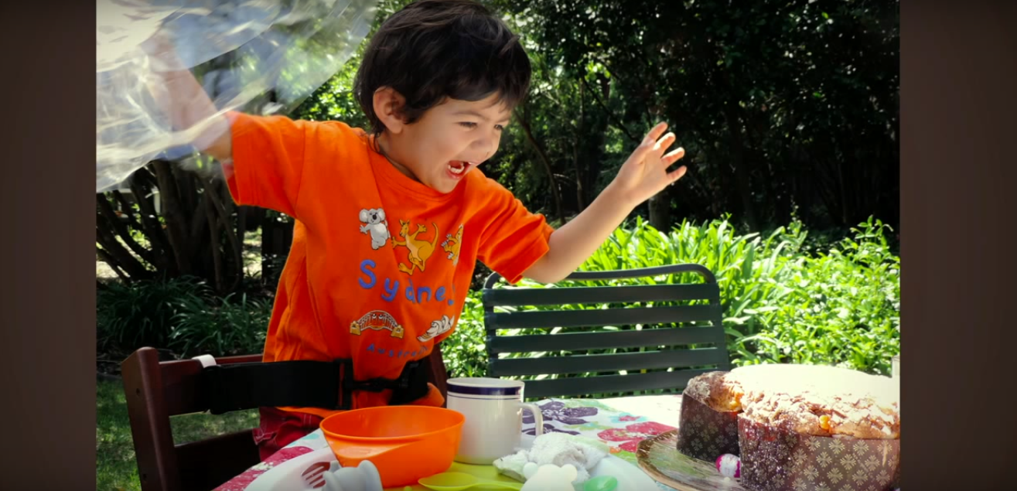

Slide 9
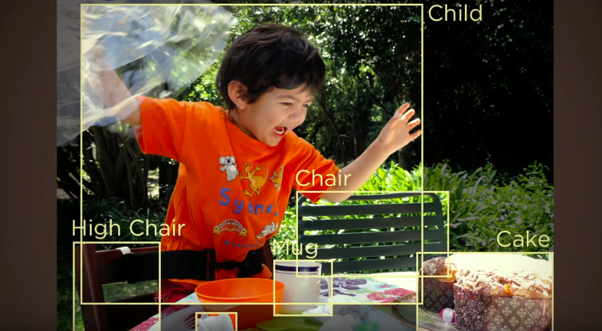
Name the Objects

Slide 10
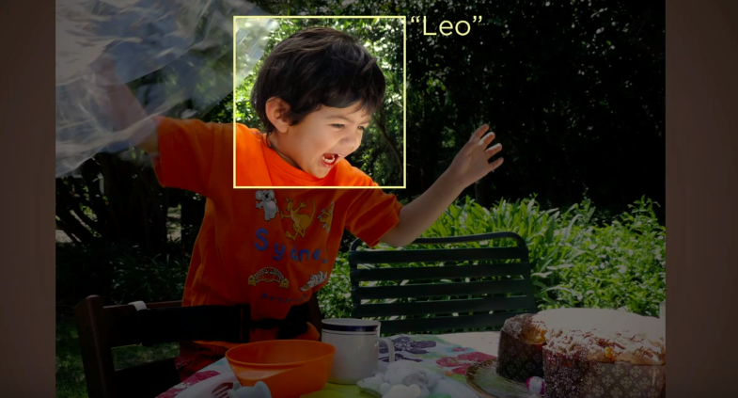
Identify People

Slide 11
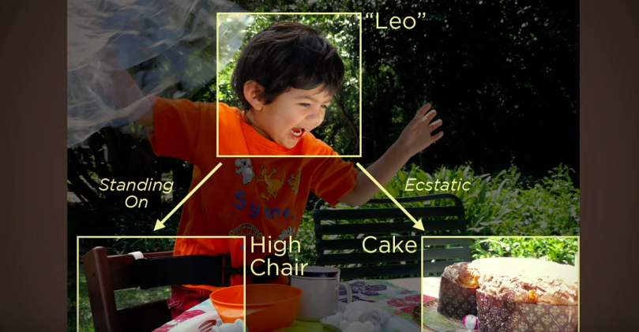
Inferring 3D Geometry of Things, Understanding relations,emotions, actions

Slide 12
To “hear” is NOT SAME as to “listen”
To “take picture” is NOT SAME to “See”
“ Seeing” means “Understanding”

Slide 13
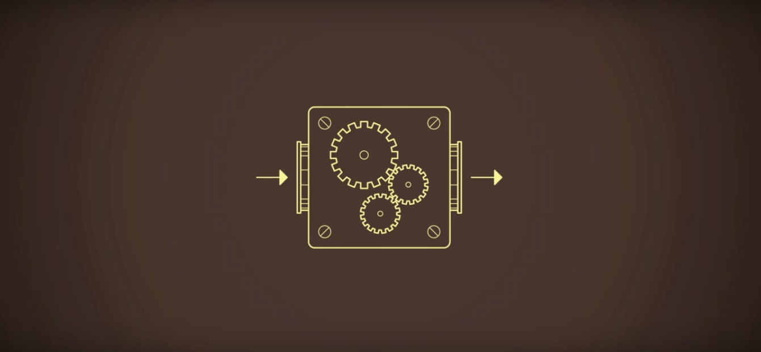
TEACH COMPUTER TO “SEE” OBJECTS
INPUT
OUTPUT

Slide 14
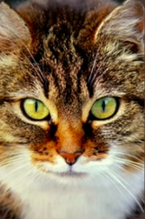
TEACH COMPUTER TO “SEE” OBJECTS
“CAT”

Slide 15
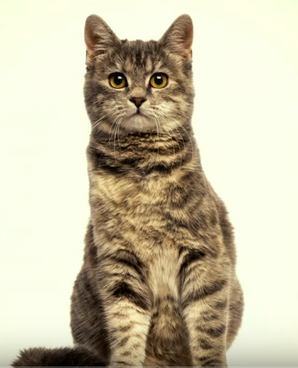
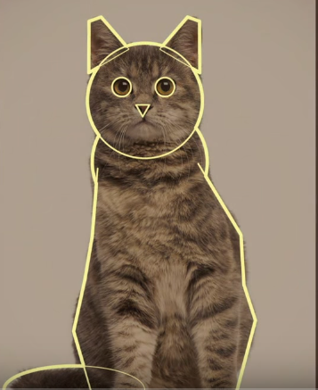

Slide 16
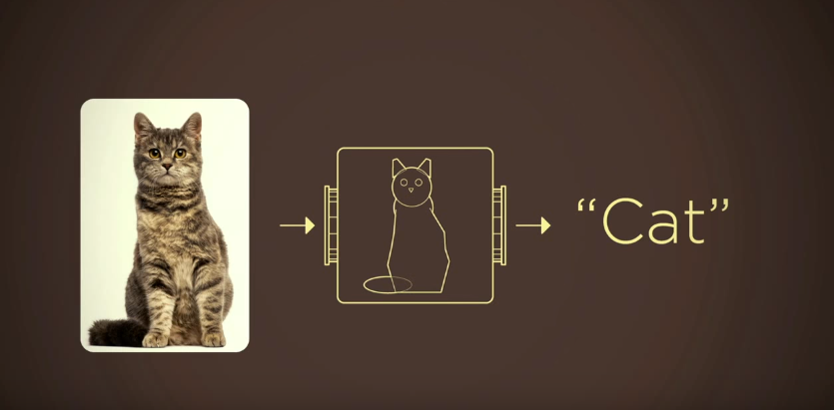
EXTRACT FEATURES
MACHINE LEARNING ALGORITHM
+

Slide 17
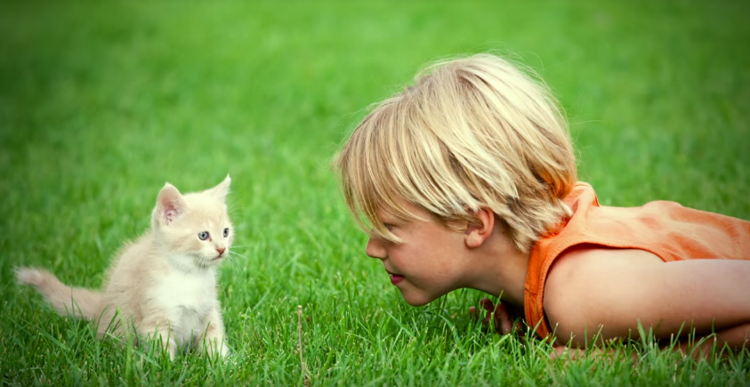
Every 200 miliseconds, one image captured

Slide 18
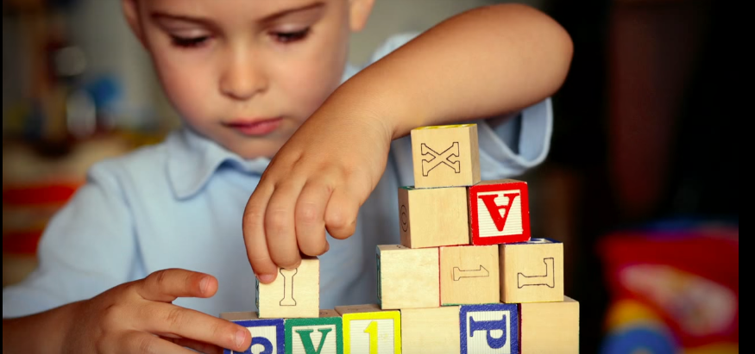
No one tell child how to see in early years
Learn through examples and experiences

Slide 19
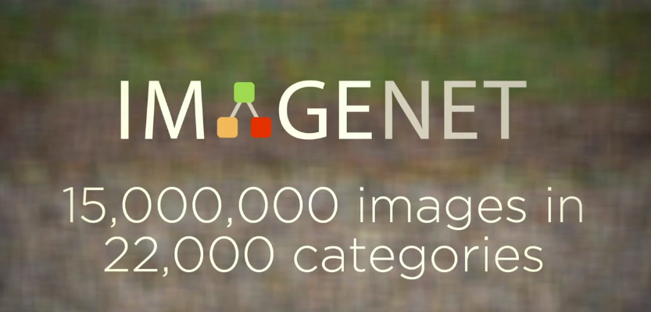

Slide 20
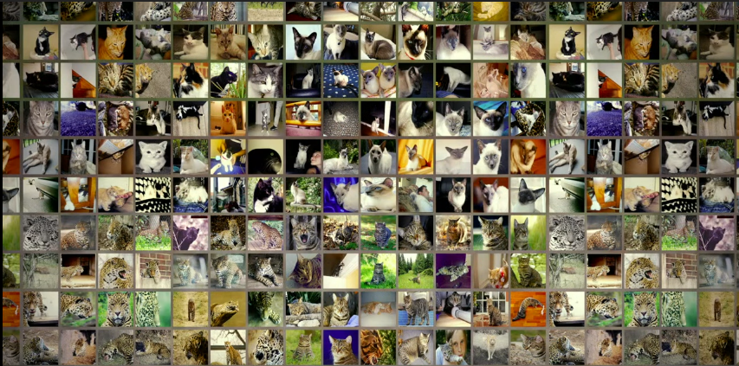

Slide 21
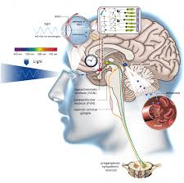
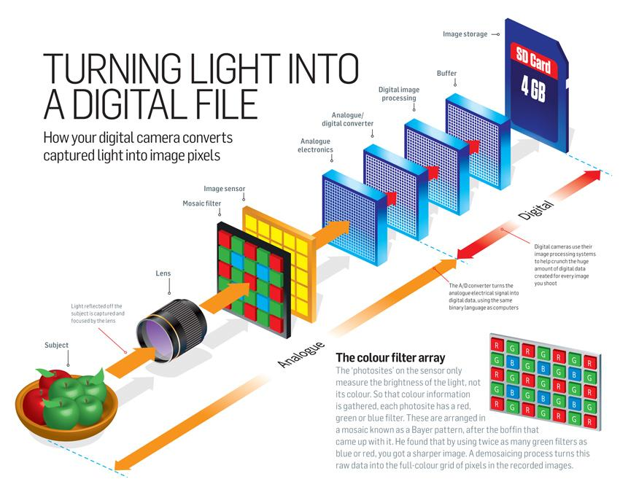

Slide 22
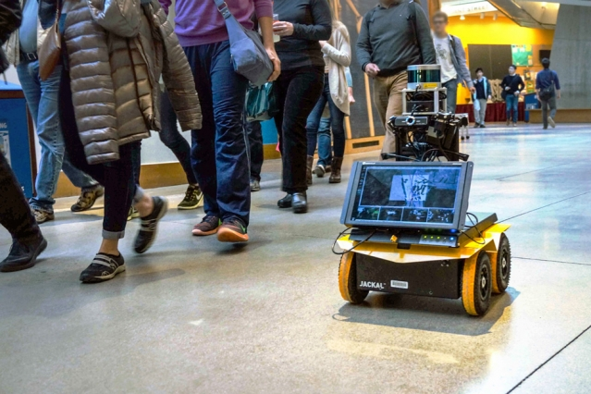
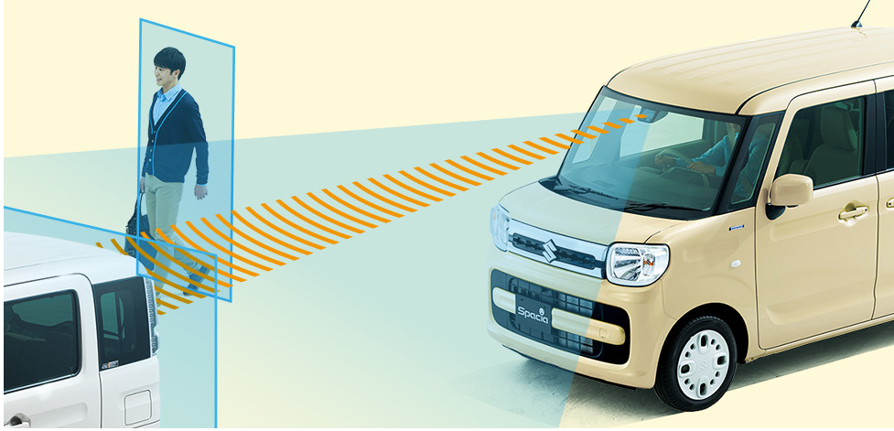
APPLICATIONS
Car Safety
Robotics (https://www.youtube.com/watch?v=CK1szio7PyA)

Slide 23


InSTALLATION ANACONDA + OPENCV CONFIGURATION
2

Slide 24
STEPS:
Step 1 Download
https://github.com/sitisofiah/Computer-Vision-101
Step 2 Download Anaconda Python 3.6 https://www.anaconda.com/download/#windows
Step 3 Go to search bar and find Anaconda Prompt
Step 4 conda install opencv
Step 5 Change directory to folder Computer Vision 101
Step 6 Launch Jupyter notebook

Slide 25
Basic ImAGE
OPERATIONS
3

Slide 26
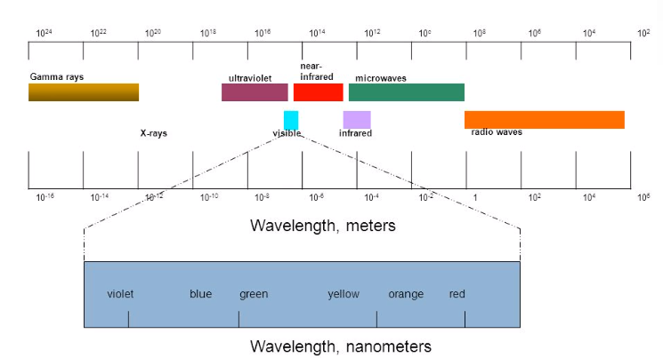
HumaN VISUAL SYSTEM

Slide 27
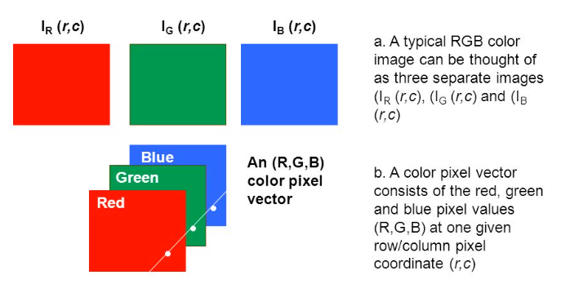
RGB color model

Slide 28
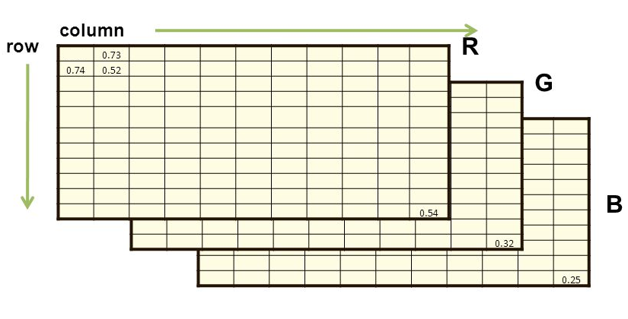
IMAGES AS MATRIX
Channel

Slide 29
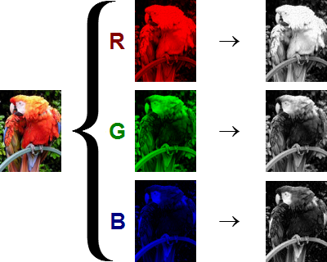
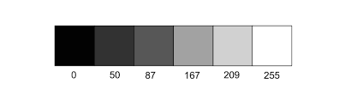
INPUT IMAGE RGB/GRAY
Images are pixels manipulation
Grayscale and RGB

Slide 30
EXERCISES
Part 1: Access and Understand Pixel Data
Part 2: Data Types and Structures
Part 3: Image Types and Color Channels

Slide 31
OVERVIEW OF OBJECT DETECTION METHODS
4

Slide 32
EXTRACT FEATURES
MACHINE LEARNING ALGORITHM
+

Slide 33
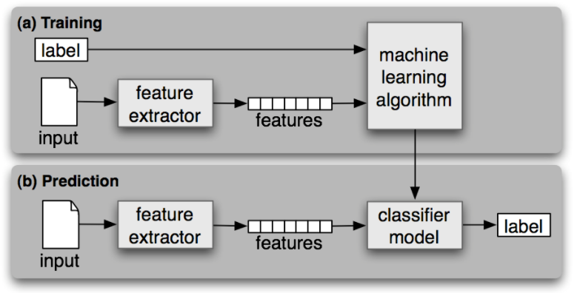
MACHINE LEARNING

Slide 34
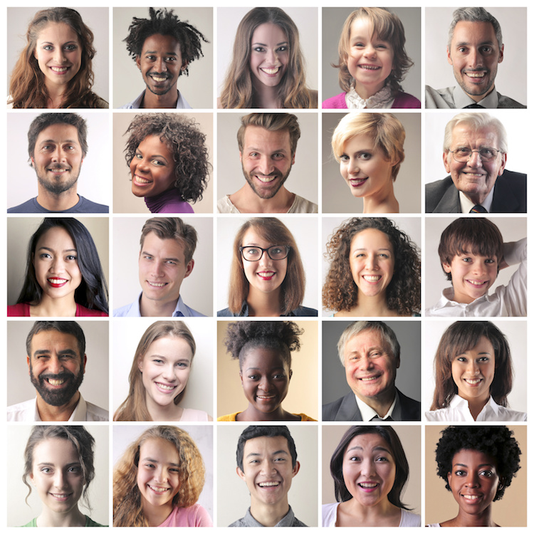
HAAR CASCADE/ VIOLA JONES
A Form of feature-based machine learning
Use pre-trained images of labeled positives and negative images
Run through thousands of of classifiers in cascaded manner
Popular case: Detect faces/eyes in images

Slide 35
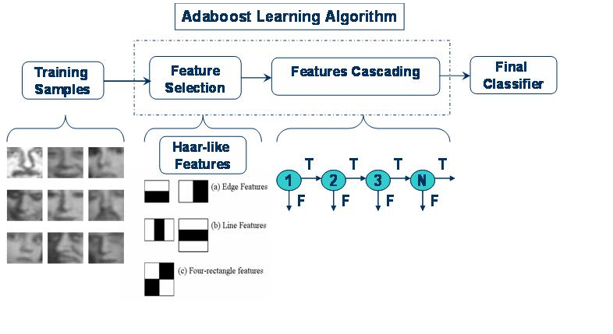
HAAR CASCADE/ VIOLA JONES

Slide 36
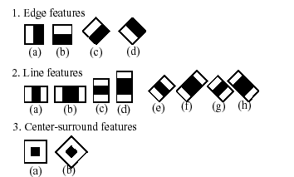
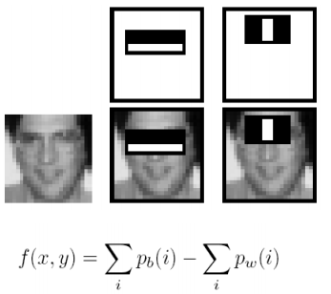
HAAR FEATURES
Compute differences between sum of pixel intensities in the light and dark rectangular regions

Slide 37
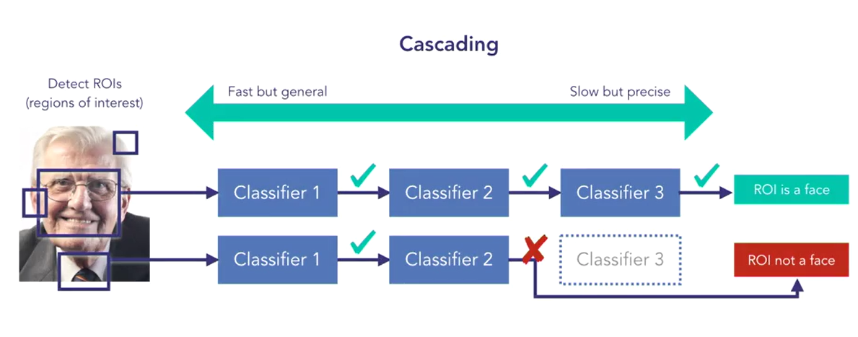
HAAR CASCADE/VIOLA JONES

Slide 38
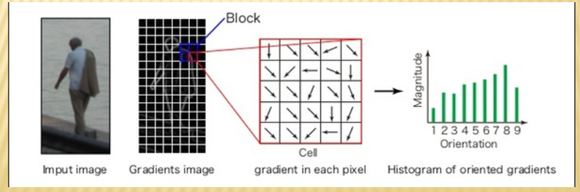
HISTOGRAM ORIENTED GRADIENTS (HOG)
Popular method detecting “PEOPLE” in static images
Partition Image into blocks and cells
Vote gradient magnitude into orientation angles

Slide 39
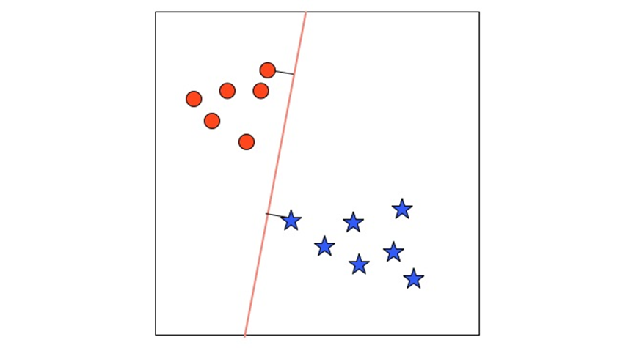
HOG + SVM
Normalised , Fixed Resolution Image, with Yes/No Annotations
Extract HOG descriptor
Learn Binary Classifier
SVM Classifier
Object Yes/No

Slide 40
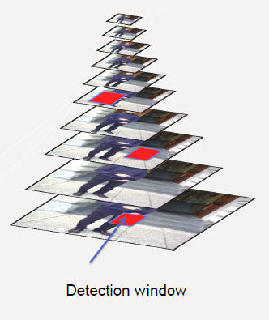
HOG MULTISCALE DETECTION
Scan Images at Different Scales and Locations
Extract HOG
Run SVM Classifier
Fuse Multiple Detection
Final Object detected

Slide 41
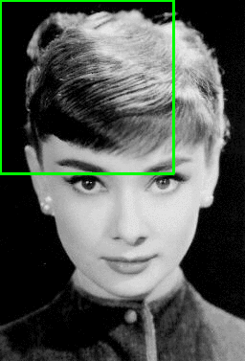
Parameters (HOG.DETECTMULTISCALE)
The winStride parameter dictates the “step size” in both the x and y-location of the sliding window.

Slide 42
Parameters (HOG.DETECTMULTISCALE)
The padding parameter is a tuple which indicates the number of pixels in both the x and y direction in
sliding window ROI is “padded” prior to HOG feature extraction.
can actually increase the accuracy of your detector.
(8, 8), (16, 16), (24, 24), and (32, 32)

Slide 43
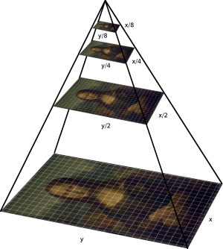
parameters
scale parameter controls the factor in which our image is resized at each layer of the image pyramid
Smaller scale higher layers in pyramid, increase computational time

Slide 44
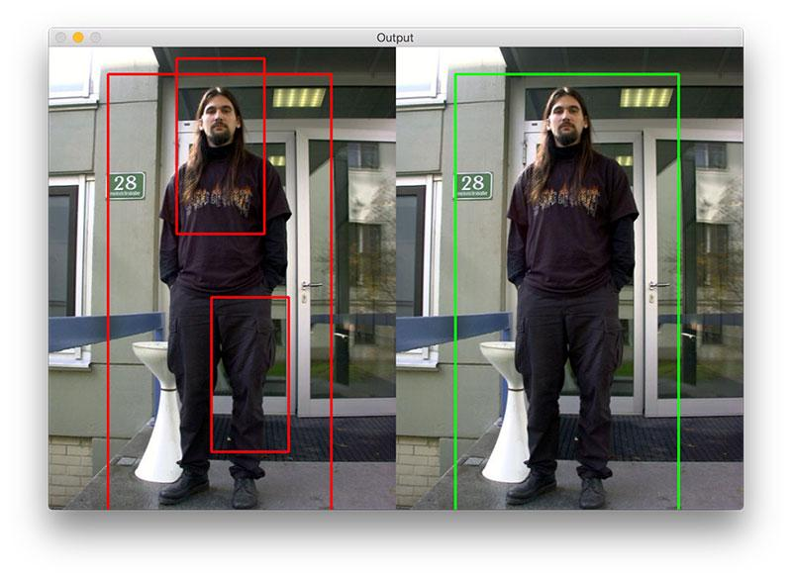
NON-MAXIMAL SUPPRESSION
To obtains much more accurate final detections
Dalal and Triggs prefer Mean-Shift

Slide 45
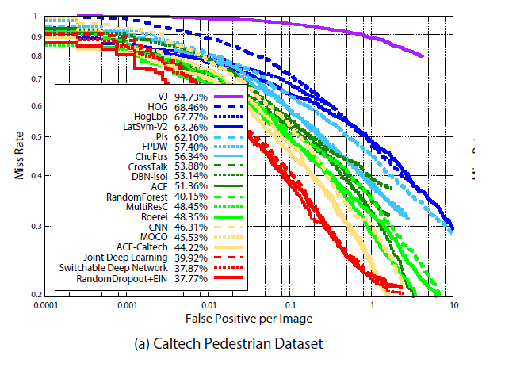
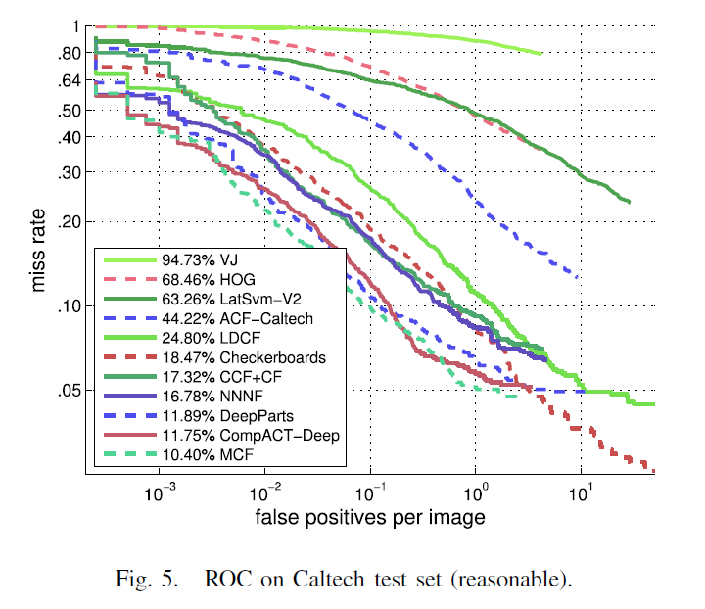
PerFORMANCE/DETECTOR BENCHMARKS
Hiroshi Fukui et. al 2015
J.Cao et. al 2017

Slide 46
HANDS ON: FACE DETECTIOn , EYE DETECTION, PEOPLE DETECTION
5

Slide 47
EXamples
Lab 1 : Face, Eye Detection (Haar) static images
Lab 2 : Human Detection (HOG) in static images
Lab 3 : Detect Human (HOG) in Video Input
Lab 4 : Detect Face/Eye (Haar) using Webcam

Slide 48
EXERCISES
6
Question 1: Create a smile detection based on live webcam
Question 2: Find image in website contain hands and create hand detection from the image

